Slide 1
Multi-Criteria Dimensionality Reduction with Applications to Fairness
Uthaipon (Tao) Tantipongpipat
Georgia Institute of Technology
Joint work with
Samira Samadi, Mohit Singh, Jamie Morgernstern, and Santosh Vempala
Notes:
Hello, my name is Tao from Georgia Institute of Technology. This is a 3-minute video presentation for the paper “Multi-Criteria Dimensionality Reduction with Applications to Fairness” in NeurIPS 2019. This work is joint with Samira Samadi, Mohit Singh, Jamie Morgernstern, and Santosh Vempala

Slide 2
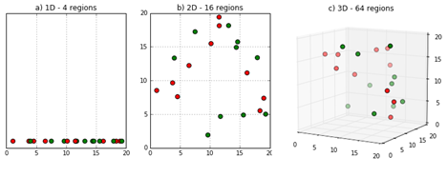
Curse of Dimensionality
Notes:
Let’s start with the motivation. When data are represented in lower dimensions, the information is denser in the space. When data are in higher dimensions, the datapoints are sparser. The sparsity in the space makes the learning machine learning models harder due to the lack of information.

Slide 3

Curse of Dimensionality
Notes:
Unfortunately, real-world data are typically complex and high-dimensional when represented in the space. For example, a string of text requires many dimensions for each characters for possible alhabets.

Slide 4
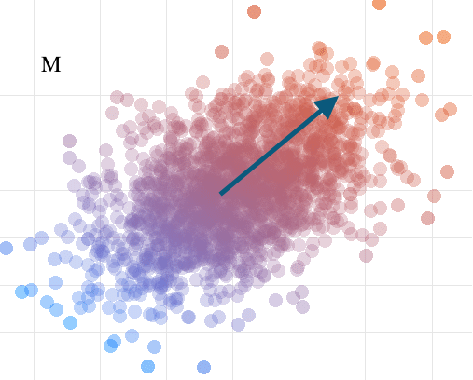
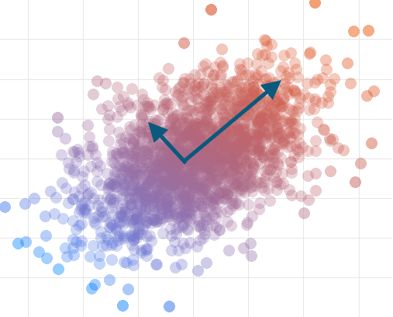
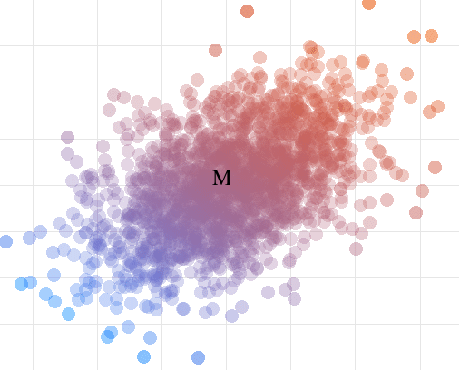
Dimensionality Reduction – Principle Component Analysis (PCA)
(Center)
Notes:
Principle Component Analysis or PCA is arguably the most widely-used technique to reduce the dimensions of the data. Suppose the data are visually represented as a cluster of points. PCA finds axes that the data will project onto. The axes should contain a lot of information of the data, which is defined as the variance of the data along that axis. In this picture, PCA would want to project along this arrow, rather than a shorter one, since the longer arrow contains more variance of the data.

Slide 5
Dimensionality Reduction – Principle Component Analysis (PCA)
(Center)
Maximizing variance = minimizing reconstruction error
Notes:
It’s also known that maximizing variance along the projection is the right objective, as it is equivalent to minimizing the reconstruction error. Reconstruction error measures how much information in the original data is lost due to projecting it into the smaller space.

Slide 6
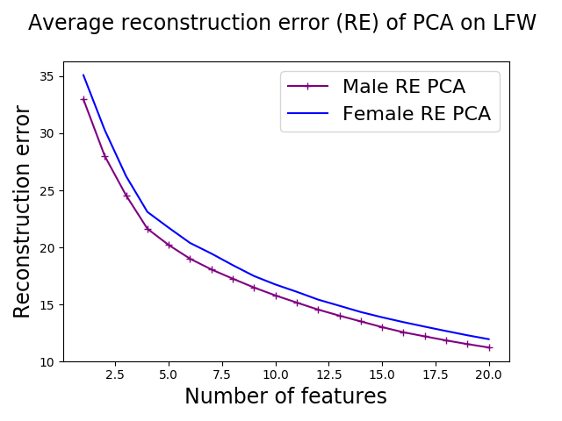
PCA can be unfair!
Standard PCA on face data LFW of male and female.
Notes:
However, this widely-used PCA can give different performance to different subgroups in the data. We perform standard PCA on face images data from thousand of dimensions to between 1 and 20 dimensions. We observe that PCA represents male population about 10% consistently better than female population.

Slide 7
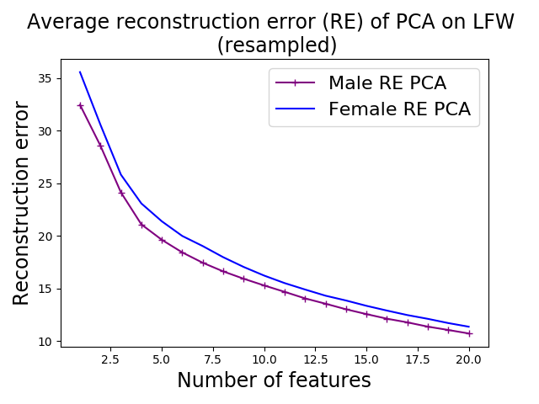
Unfair PCA
Standard PCA on face data LFW of male and female.
Equalizing male and female weight before PCA
Notes:
The same observation is true even when we reweight each population to have equal weights. This is concerning because projected data are later used in machine learning algorithms to make prediction and decisions, and unfairness may already be introduced at this point.

Slide 8
Main Contributions
Notes:
Now I want to present our contributions.

Slide 9
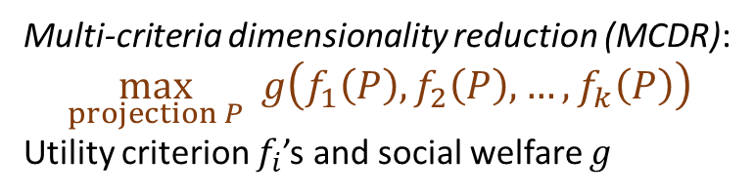
Problem Formulation
Multi-criteria dimensionality reduction (MCDR):
$$\max_{projection P} g\left(f_{1}\left(P\right), f_{2}\left(P\right), …, f_{k}\left(P\right)\right)$$
Utility criterion $f_{i}$’s and social welfare $g$
Main Contributions
Notes:
Our first contribution is to formulate the problem as multi-criteria dimensionality reduction or MCDR. Instead of maximizing total variance as in standard PCA, we allow two modifications. First, instead of variance, each group can also have their own utility criterion, which may be more suitable depending on the context. Second, we allow more general social welfare function g, not just the sum.

Slide 10
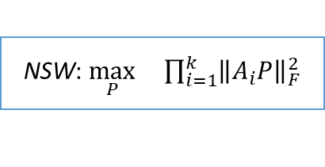

Mar-Loss: $\min_{P}\max_{i∈\{1,…,k\}}\left(\max_{Q}{{\left\|A_{i}Q\right\|}_{F}^{2}}−{\left\|A_{i}P\right\|}_{F}^{2}\right)$
NSW: $\max_{P} \prod_{i=1}^{k}{{\left\|A_{i}P\right\|}_{F}^{2}}$
Problem Formulation
Multi-criteria dimensionality reduction (MCDR):
$$\max_{projection P} g\left(f_{1}\left(P\right), f_{2}\left(P\right), …, f_{k}\left(P\right)\right)$$
Utility criterion $f_{i}$’s and social welfare $g$
Main Contributions
Notes:
To give an example, Marginal Loss objective uses the utility function as the marginal variance each group loses due to the presence of other groups. The social welfare g is taken to be the worst-performing group.
Nash social welfare objective, or NSW, takes utility function as variance as standard PCA, but uses product instead of sum for social welfare utility.

Slide 11

Mar-Loss: $\min_{P}\max_{i∈\{1,…,k\}}\left(\max_{Q}{{\left\|A_{i}Q\right\|}_{F}^{2}}−{\left\|A_{i}P\right\|}_{F}^{2}\right)$
NSW: $\max_{P} \prod_{i=1}^{k}{{\left\|A_{i}P\right\|}_{F}^{2}}$
Problem Formulation
Algorithms and Performance Guarantee
Multi-criteria dimensionality reduction (MCDR):
$$\max_{projection P} g\left(f_{1}\left(P\right), f_{2}\left(P\right), …, f_{k}\left(P\right)\right)$$
Utility criterion $f_{i}$’s and social welfare $g$
Main Contributions
On linear $f_{i}$ in $PP^{T}$ and concave $g$:
Notes:
Our second contribution is to give a polynomial-time algorithm to solve MCDR. We assume $f_{i}$’s are linear in projection matrix $PP^{T}$ and concave $g$. This class of f_i and g includes well-studied welfare objectives including marginal loss and Nash Social Welfare.

Slide 12
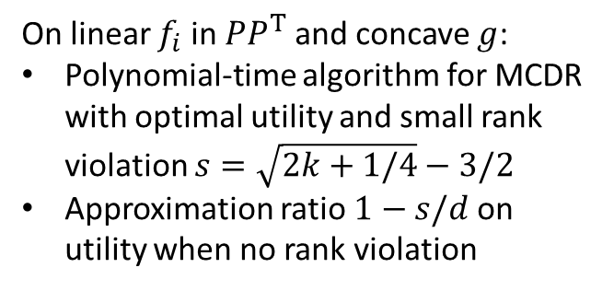
Mar-Loss: $\min_{P}\max_{i∈\{1,…,k\}}\left(\max_{Q}{{\left\|A_{i}Q\right\|}_{F}^{2}}−{\left\|A_{i}P\right\|}_{F}^{2}\right)$
NSW: $\max_{P} \prod_{i=1}^{k}{{\left\|A_{i}P\right\|}_{F}^{2}}$
Problem Formulation
Algorithms and Performance Guarantee
Multi-criteria dimensionality reduction (MCDR):
$$\max_{projection P} g\left(f_{1}\left(P\right), f_{2}\left(P\right), …, f_{k}\left(P\right)\right)$$
Utility criterion $f_{i}$’s and social welfare $g$
Main Contributions
On linear $f_{i}$ in $PP^{T}$ and concave $g$:
Polynomial-time algorithm for MCDR with optimal utility and small rank violation $s=\sqrt{2k+1/4}−3/2$
Approximation ratio $1−s/d$ on utility when no rank violation
Notes:
The algorithm has performance guarantee that achieves optimal output with small rank violation. What that means is that, in stead of projecting to the target rank d, it may project to at most d+s where s is roughly square root k.
For certain g we can use a scaling technique to avoid rank violation and achieve multiplicative approximation factor 1-s/d instead.

Slide 13
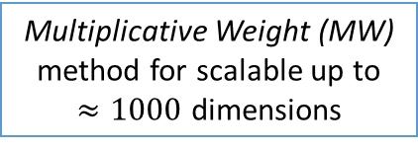
Mar-Loss: $\min_{P}\max_{i∈\{1,…,k\}}\left(\max_{Q}{{\left\|A_{i}Q\right\|}_{F}^{2}}−{\left\|A_{i}P\right\|}_{F}^{2}\right)$
Multiplicative Weight (MW) method for scalable up to
$≈1000$ dimensions
NSW: $\max_{P} \prod_{i=1}^{k}{{\left\|A_{i}P\right\|}_{F}^{2}}$
Problem Formulation
Algorithms and Performance Guarantee
Multi-criteria dimensionality reduction (MCDR):
$$\max_{projection P} g\left(f_{1}\left(P\right), f_{2}\left(P\right), …, f_{k}\left(P\right)\right)$$
Utility criterion $f_{i}$’s and social welfare $g$
Main Contributions
On linear $f_{i}$ in $PP^{T}$ and concave $g$:
Polynomial-time algorithm for MCDR with optimal utility and small rank violation $s=\sqrt{2k+1/4}−3/2$
Approximation ratio $1−s/d$ on utility when no rank violation
Notes:
We also provide an alternative method for solving MCDR problem using multiplicative weight update. This method scales well in practice to thousands of dimensions.

Slide 14
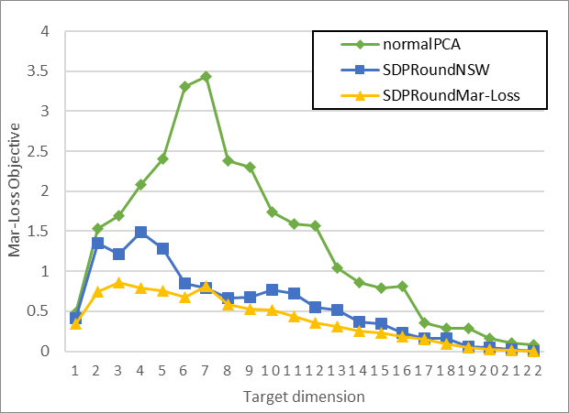
Marginal Loss objective
Mar-Loss: $\min_{P}\max_{i∈\{1,…,k\}}\left(\max_{Q}{{\left\|A_{i}Q\right\|}_{F}^{2}}−{\left\|A_{i}P\right\|}_{F}^{2}\right)$
Multiplicative Weight (MW) method for scalable up to
$≈1000$ dimensions
NSW: $\max_{P} \prod_{i=1}^{k}{{\left\|A_{i}P\right\|}_{F}^{2}}$
Problem Formulation
Algorithms and Performance Guarantee
Multi-criteria dimensionality reduction (MCDR):
$$\max_{projection P} g\left(f_{1}\left(P\right), f_{2}\left(P\right), …, f_{k}\left(P\right)\right)$$
Utility criterion $f_{i}$’s and social welfare $g$
Main Contributions
On linear $f_{i}$ in $PP^{T}$ and concave $g$:
Polynomial-time algorithm for MCDR with optimal utility and small rank violation $s=\sqrt{2k+1/4}−3/2$
Approximation ratio $1−s/d$ on utility when no rank violation
Notes:
With our algorithm, we achieve a fairer PCA. We perform an experiment on Credit data with 6 groups based on education and gender and look at the marginal loss objective. Our algorithm which we called SDP-Round either tries to minimize Marginal Loss or Nash Social Welfare. We see that the new algorithm vastly reduces the marginal loss compared to the standard PCA. Interestingly, even if SDP-Round tries to achieve in one objective NSW, it also performs well on other fairness objective namely marginal loss.

Slide 15
Marginal Loss objective
Mar-Loss: $\min_{P}\max_{i∈\{1,…,k\}}\left(\max_{Q}{{\left\|A_{i}Q\right\|}_{F}^{2}}−{\left\|A_{i}P\right\|}_{F}^{2}\right)$
Multiplicative Weight (MW) method for scalable up to
$≈1000$ dimensions
NSW: $\max_{P} \prod_{i=1}^{k}{{\left\|A_{i}P\right\|}_{F}^{2}}$
Problem Formulation
Algorithms and Performance Guarantee
Multi-criteria dimensionality reduction (MCDR):
$$\max_{projection P} g\left(f_{1}\left(P\right), f_{2}\left(P\right), …, f_{k}\left(P\right)\right)$$
Utility criterion $f_{i}$’s and social welfare $g$
Main Contributions
On linear $f_{i}$ in $PP^{T}$ and concave $g$:
Polynomial-time algorithm for MCDR with optimal utility and small rank violation $s=\sqrt{2k+1/4}−3/2$
Approximation ratio $1−s/d$ on utility when no rank violation
Theory: low-rank property in semi-definite program (SDP)
Every extreme point of the SDP-Relaxation of MCDR has low rank.
Optimization result + ML application
Notes:
The performance guarantee on the theory of semi-definite programming. We extend the low-rank property result of extreme points of semi-definite programming more generally to apply to MCDR. Our work connects known result in optimization community with an application in machine learning community.

Slide 16

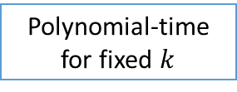
Marginal Loss objective
Mar-Loss: $\min_{P}\max_{i∈\{1,…,k\}}\left(\max_{Q}{{\left\|A_{i}Q\right\|}_{F}^{2}}−{\left\|A_{i}P\right\|}_{F}^{2}\right)$
Multiplicative Weight (MW) method for scalable up to
$≈1000$ dimensions
NSW: $\max_{P} \prod_{i=1}^{k}{{\left\|A_{i}P\right\|}_{F}^{2}}$
Problem Formulation
Algorithms and Performance Guarantee
Multi-criteria dimensionality reduction (MCDR):
$$\max_{projection P} g\left(f_{1}\left(P\right), f_{2}\left(P\right), …, f_{k}\left(P\right)\right)$$
Utility criterion $f_{i}$’s and social welfare $g$
Main Contributions
On linear $f_{i}$ in $PP^{T}$ and concave $g$:
Polynomial-time algorithm for MCDR with optimal utility and small rank violation $s=\sqrt{2k+1/4}−3/2$
Approximation ratio $1−s/d$ on utility when no rank violation
Theory: low-rank property in semi-definite program (SDP)
Complexity of MCDR
Every extreme point of the SDP-Relaxation of MCDR has low rank.
Optimization result + ML application
Polynomial-time for fixed $k$
NP-hard for general $k$
Reduction to MAX-CUT
Algorithmic theory of quadratic maps.
Notes:
Finally, we analyze the complexity of MCDR problems. We show NP-hardness of MCDR when k is part of the input by reducing the problem to MAX-CUT, and show polynomial-time solvability for fixed k using an algorithmic theory of quadratic maps.

Slide 17
Marginal Loss objective
Mar-Loss: $\min_{P}\max_{i∈\{1,…,k\}}\left(\max_{Q}{{\left\|A_{i}Q\right\|}_{F}^{2}}−{\left\|A_{i}P\right\|}_{F}^{2}\right)$
Multiplicative Weight (MW) method for scalable up to
$≈1000$ dimensions
NSW: $\max_{P} \prod_{i=1}^{k}{{\left\|A_{i}P\right\|}_{F}^{2}}$
Problem Formulation
Algorithms and Performance Guarantee
Multi-criteria dimensionality reduction (MCDR):
$$\max_{projection P} g\left(f_{1}\left(P\right), f_{2}\left(P\right), …, f_{k}\left(P\right)\right)$$
Utility criterion $f_{i}$’s and social welfare $g$
Main Contributions
On linear $f_{i}$ in $PP^{T}$ and concave $g$:
Polynomial-time algorithm for MCDR with optimal utility and small rank violation $s=\sqrt{2k+1/4}−3/2$
Approximation ratio $1−s/d$ on utility when no rank violation
Theory: low-rank property in semi-definite program (SDP)
Complexity of MCDR
Every extreme point of the SDP-Relaxation of MCDR has low rank.
Optimization result + ML application
Polynomial-time for fixed $k$
NP-hard for general $k$
Reduction to MAX-CUT
Algorithmic theory of quadratic maps.
Code: github.com/SDPforAll/multiCriteriaDimReduction
Web: sites.google.com/site/ssamadi/fair-pca-homepage
Notes:
The code is publicly available You can also find more information at the webpage shown here or our paper. Thank you for listening

